Slide 1
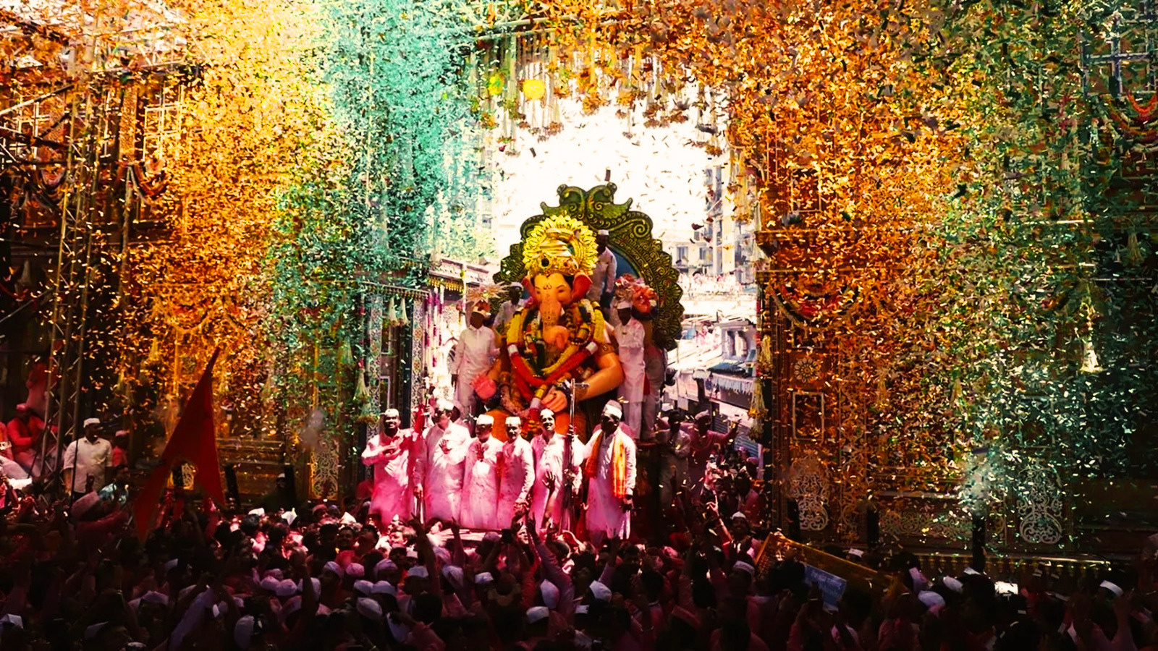

R E D F M P R E S E N T S
RED CHA
R A J A
Utsav Anandacha
11TH SEPT – 25TH SEPT

Slide 2
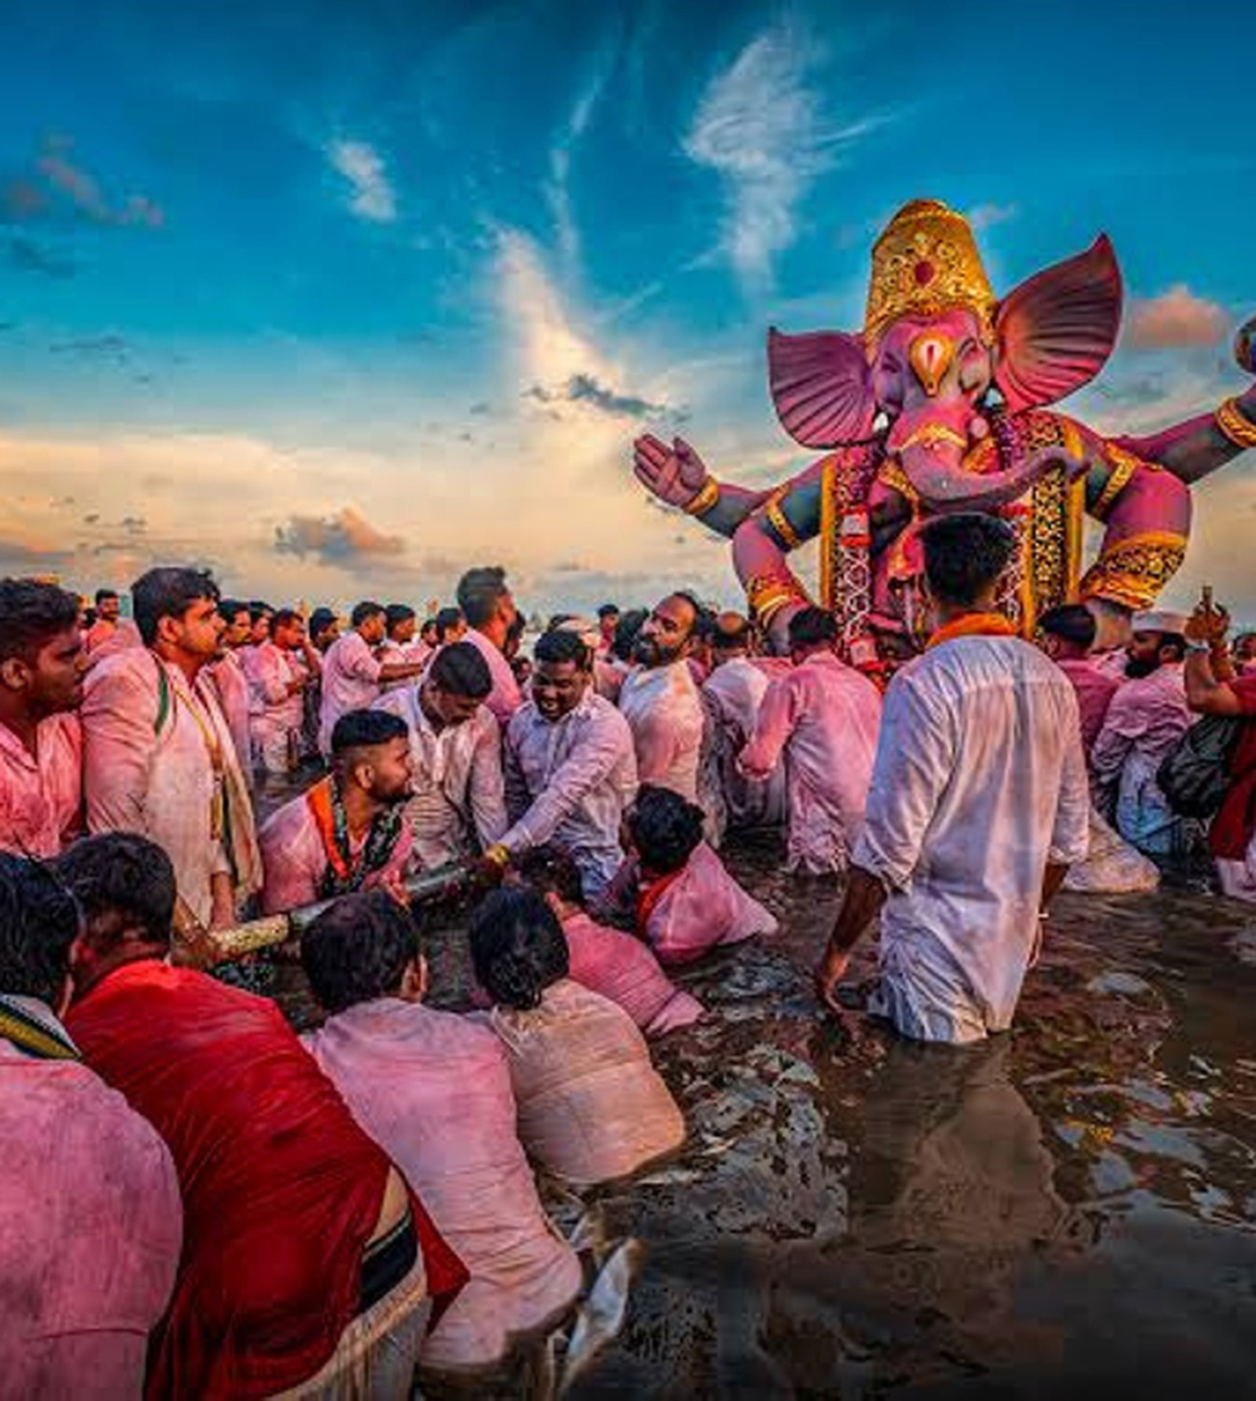
R E D C H A R A J A
Celebrating Maharashtra's Biggest Community Festival
Ganeshotsav is more than a festival, it's Maharashtra's biggest community celebration. Every year, lakhs of people come together to welcome Bappa home, turning every lane, society, pandal and neighborhood into a celebration of faith, culture and togetherness.
RED Cha Raja is RED FM's on ground journey through this celebration.
From the first idol taking shape to the final visarjan, we'll travel across Maharashtra, capturing the people, traditions and emotions that make Ganeshotsav truly unforgettable.
02 / 15

Slide 3
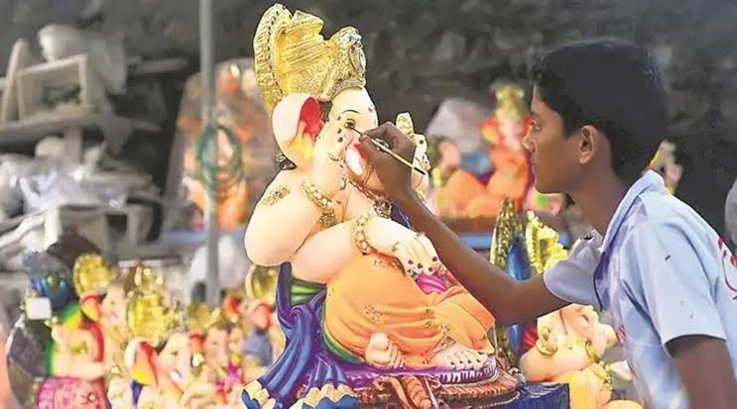
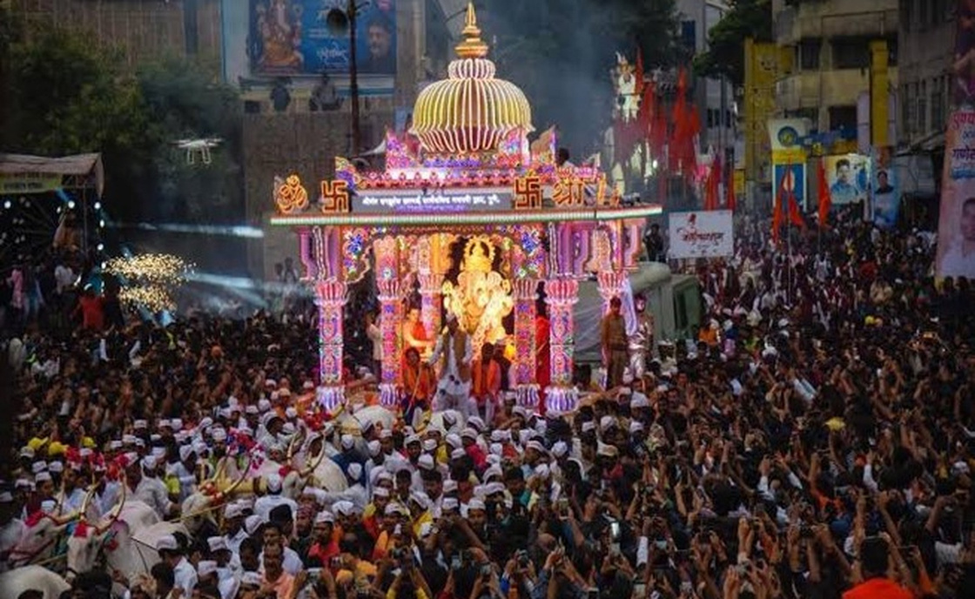
F R O M P R E P A R A T I O N T O C E L E B R A T I O N
MORNING SHOW
EVENING SHOW
The Makers of Ganpati
The Spirit of Ganpati
Morning celebrates the people who make Ganpati. Beyond the pandals, we'll celebrate the real heroes of Ganeshotsav — murtikars, modak makers, florists, artisans, volunteers, devotees and families — showcasing the stories, traditions and hard work that come together to welcome Bappa.
Shows step out of the studio and into Maharashtra's grandest pandals, bringing to listeners live celebrations and the festive pulse of Bappa's biggest celebrations. Evening celebrates the people who celebrate Ganpati.
03 / 15

Slide 4
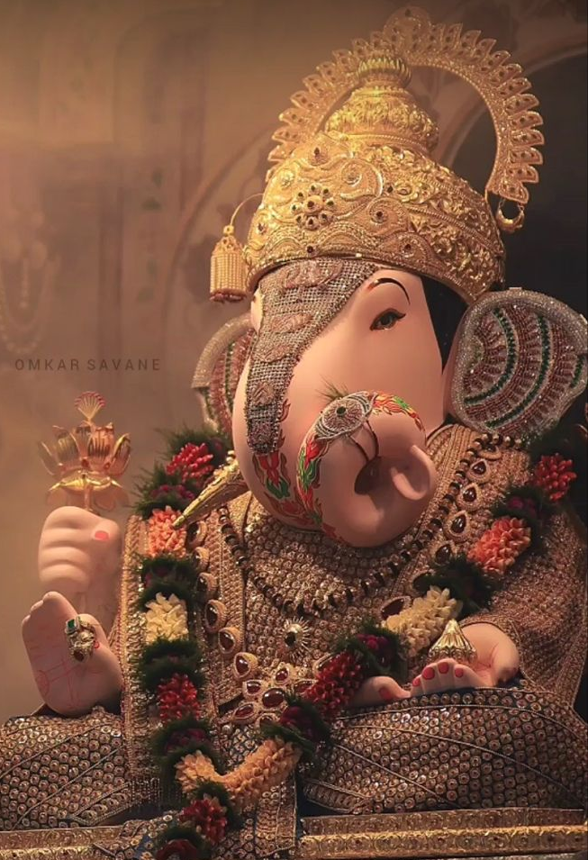
W H A T T O E X P E C T O N R A D I O
01
Heartfelt Conversations
Devotees, celebrities, artisans, organizers & festival heroes.
02
Pandal Hopping
Live from iconic pandals, hidden gems & celebrity aartis
03
Ganpati Stories
Legendary pandals, history, unique traditions & cultural heritage.
04
Sounds of Ganeshotsav
Aartis, dhol-tasha & chants of Ganpati Bappa Morya and the electrifying
spirit of the Visarjan miravnuk.
05
Festival Updates
Traffic, visarjan routes, events & community initiatives.
04 / 15

Slide 5
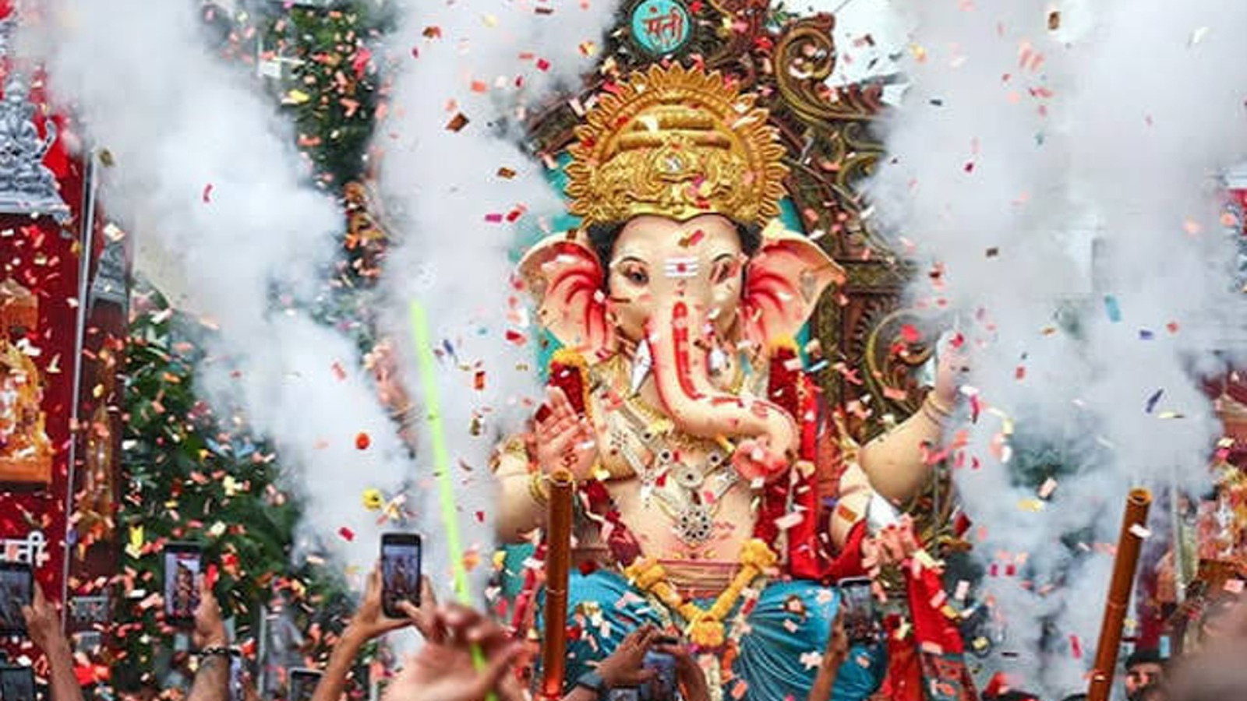
M A R K E T S
RED FM will capture the grandeur of this Ganeshotsav across the key cities of Maharashtra with the message :
Bappa is for everyone
Mumbai
Pune
Nagpur
Nashik
Chhatrapati Sambhajinagar
Nanded
Dhule
05 / 15

Slide 6
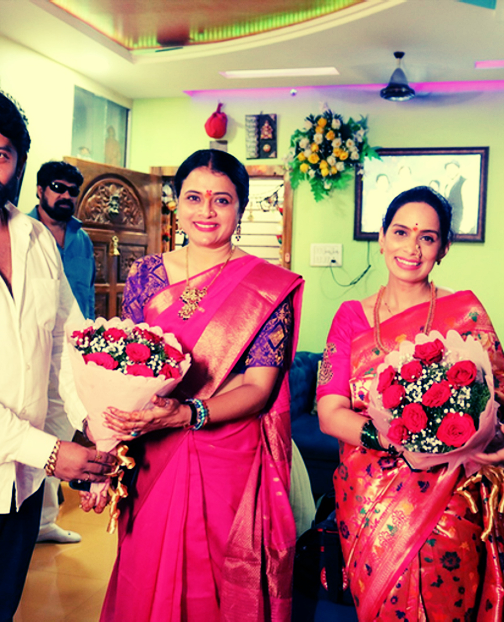
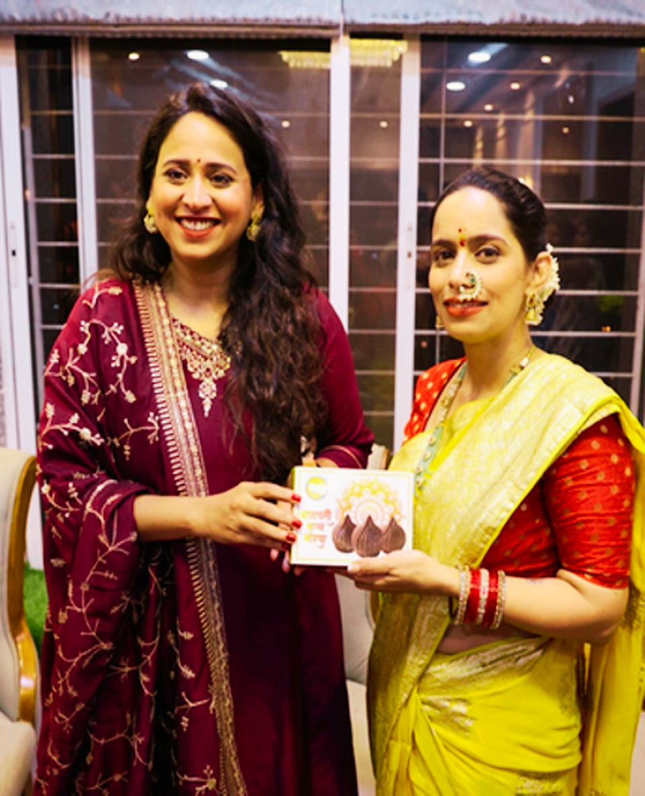
C O N T E N T P I E C E S
Superstar Aarti
Bachpan ki Bappa Stories
RED FM brings popular movie and TV celebrities to perform Ganpati Aarti at selected listener homes, creating memorable festive experiences.
The activity gives brands strong visibility through celebrity participation, branded hampers, engaging on-air links & digital reels.
Popular celebrities share their fondest Ganeshotsav memories, traditions, and childhood moments.
The activity creates engaging on-air and digital content, creating authentic opportunities for brand integration.
06 / 15

Slide 7
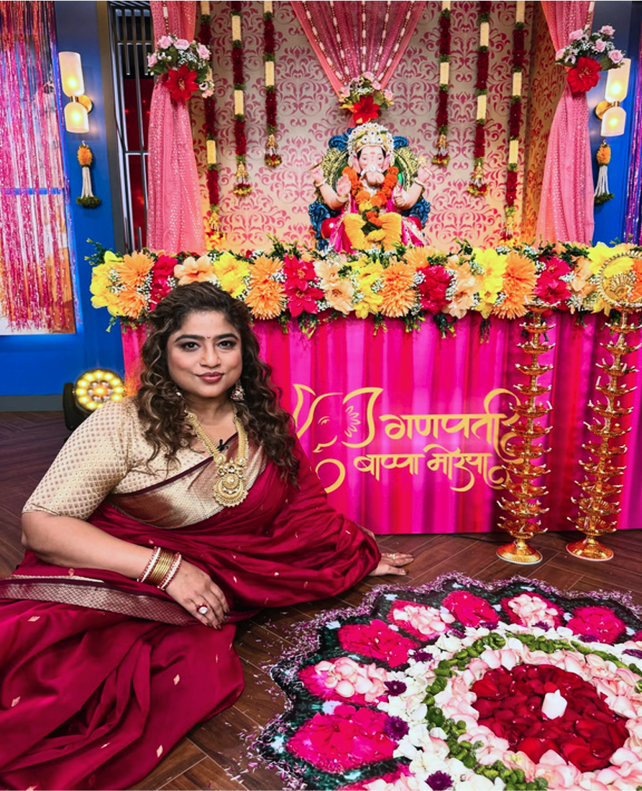
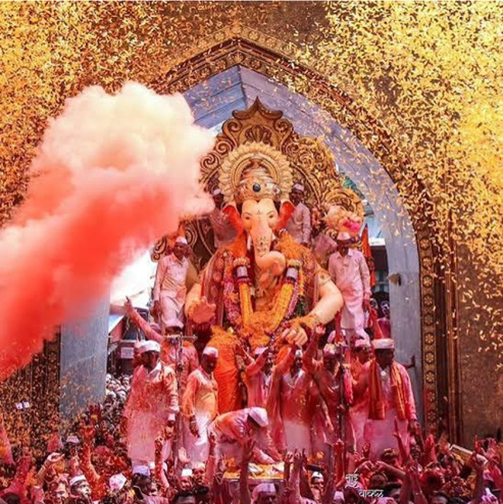
C O N T E N T P I E C E S
RJ Pandal Hopping
Bappa Ka Thappa
RJs go live from the city's iconic Ganesh pandals, uncovering the stories, traditions, history and unique decoration themes through conversations with organizers, priests, decorators and devotees delivering immersive on-air and digital content while taking listeners closer to the city's most celebrated Ganeshotsav experiences.
RED FM celebrates a Ganeshotsav that inspires honoring eco-conscious idols, thoughtful pandals, and celebrations that respect nature and every living being.
The best entries earn the coveted Bappa Ka Thappa, on-air recognition, digital amplification and exciting rewards.
07 / 15

Slide 8
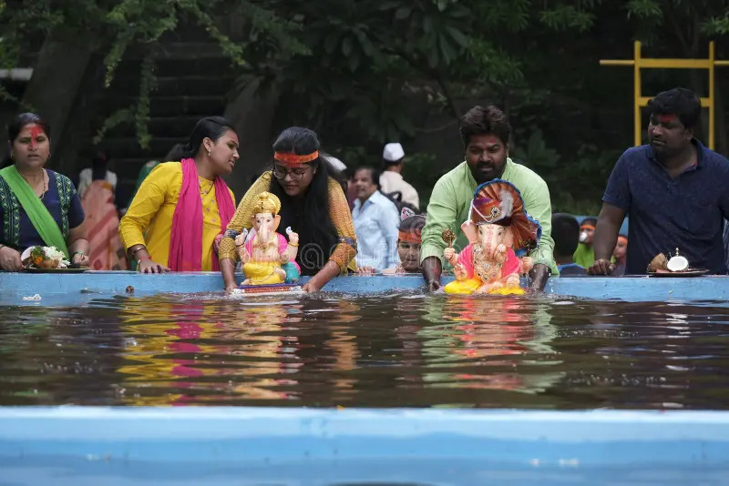
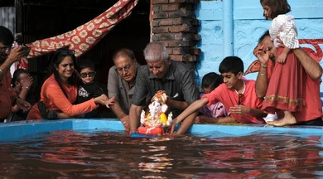
C O N T E N T P I E C E S
*Visarjan Squad
You celebrate the devotion. We handle the arrangements.
The last goodbye to Bappa is emotional and meaningful. Our Visarjan Squad ensures every ritual is taken care of - from arranging a Guruji and miravnuk vehicle to guiding devotees towards responsible, eco-friendly visarjan.
Driven through the Evening Show
Dates: 15th Sept (1.5 Day Visarjan)
18th Sept (5th Day Visarjan)
20th Sept (7th Day Visarjan)
25th sept (12th Day Visarjan)
*Applicable only in markets where the property is sold.
07 / 15

Slide 9
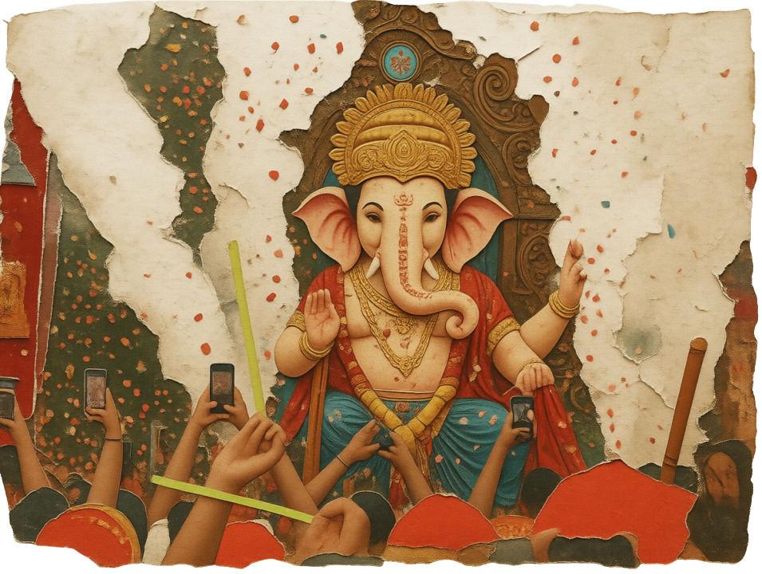
E L E M E N T S
ON AIR ELEMENTS
DIGITAL ELEMENTS
Promos
Bachpan ki Bappa Stories
RJ Mentions
Bappa ka Thappa
RJ's live from Pandals
Superstar Aarti
*Visarjan Squad
Bachpan Ki Bappa Stories
Bappa ka Thappa
Superstar Aarti
*Visarjan Squad
08 / 15

Slide 10
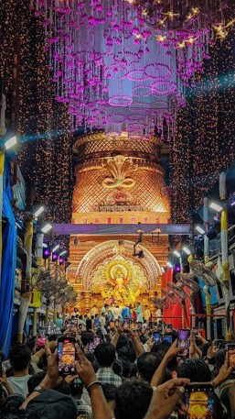
E X P O S U R E S
—
Promos & RJ Mentions
Refer to the deliverables grid
8
Bachpan ki Bappa Stories
during the activity
3
Superstar Aarti visits
during the activity (2 RJ links each)
36
RJ links from famous Pandals
during the activity
5
Bappa ka Thappa
during the activity
4
*Visarjan Squad
during the activity (Applicable only in markets where the property is sold)
09 / 15

Slide 11
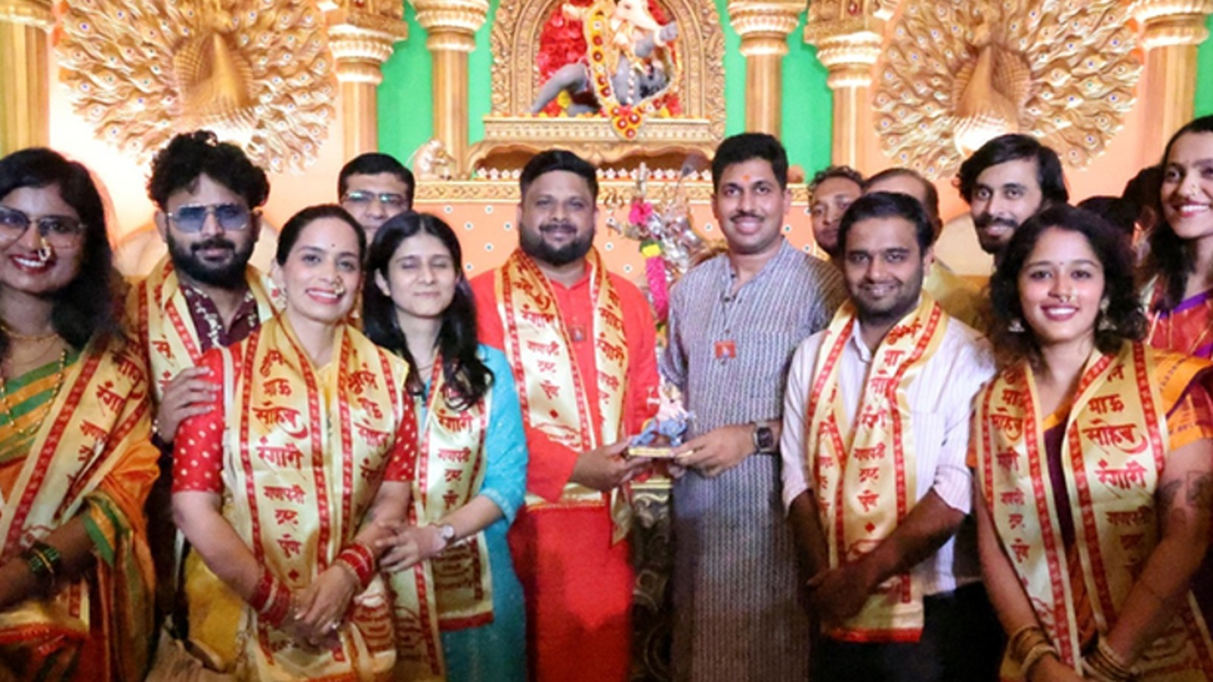
O N A I R D E L I V E R A B L E S G R I D
01
Title Partner
02
Presenting Partner
Opening brand name and a 7-second closing tag.
Opening brand name and a 7-second closing tag.
03
Co-powered by Partner
04
Associate Partners
5-second closing tag.
Up to four partners with 3-second closing tags that rotate alternately.
10 / 15

Slide 12
O N A I R D E L I V E R A B L E S
RED CHA RAJA — MAHARASHTRA
Ganpati starts (14 Sep) • 1.5-Day Visarjan (15 Sep) • 5th-Day Visarjan (18 Sep) • 7th-Day Visarjan (20 Sep) • 12th-Day Visarjan (25 Sep)
RED CHA RAJA - MAHARASHTRA |  | Fri | Sat | Sun | Mon | Tue | Wed | Thurs | Fri | Sat | Sun | Mon | Tue | Wed | Thurs | Fri
Elements | Show/Playout | 11th Sept | 12th Sept | 13th Sept | 14th Sept | 15th Sept | 16th Sept | 17th Sept | 18th Sept | 19th Sept | 20th Sept | 21st Sept | 22nd Sept | 23rd Sept | 24th Sept | 25th Sept
 |  | PRE PRO | PRE PRO | PRE PRO | Ganpati starts | 1.5 Day Visarjan |  |  | 5th Day Visarjan |  | 7th Day Visarjan |  |  |  |  | 12th day Visarjan | Total
Activity Promos | All day | 20 | 20 | 24 | 20 | 13 | 14 | 14 | 11 | 16 | 23 | 14 | 12 | 14 | 12 | 19 | 246
Generic mentions | Morning | 1 | 1 |  | 1 |  |  |  |  |  |  |  |  |  |  |  | 3
 | Mid Morning | 1 | 1 |  | 1 | 1 | 1 | 1 | 1 | 1 |  | 1 | 1 | 1 | 1 | 1 | 13
 | Afternoon | 1 | 1 |  | 1 | 1 | 1 | 1 | 1 | 1 |  | 1 | 1 | 1 | 1 | 1 | 13
 | Evening Show | 1 | 1 |  | 1 |  |  |  |  |  |  |  |  |  |  |  | 3
RJ visit links | Morning |  |  |  |  | 2 | 2 | 2 | 2 | 2 |  | 2 | 2 | 2 | 2 | 2 | 20
Celeb's Bappa story | Morning show |  |  |  |  | 1 | 1 | 1 | 1 |  |  | 1 | 1 | 1 | 1 |  | 8
Superstar Aarti links | Midmorning show |  |  |  |  |  |  |  | 2 |  |  |  | 2 |  | 2 |  | 6
RJ links (Evening shows from famous pandals) | Evening Show |  |  |  |  | 4 | 4 | 4 | 4 | 4 |  | 4 | 4 | 4 | 4 |  | 36
Bappa ka Thappa | Evening Show |  |  |  |  | 1 | 1 | 1 | 1 |  |  | 1 | 1 | 1 | 1 |  | 8
*Visarjan Squad (Only in markets where it's sold) | Evening Show |  |  |  |  | 1 |  |  | 1 |  | 1 |  |  |  |  | 1 | 4
Total Exposure per day |  | 24 | 24 | 24 | 24 | 24 | 24 | 24 | 24 | 24 | 24 | 24 | 24 | 24 | 24 | 24 | 360
11 / 15

Slide 13
MARKETING
12 / 15

Slide 14
DIGITAL DELIVERABLES
Pre-Promotion Phase
3 Days Pre-Promotion On Red FM Marathi Social Handles + Amplification On RJ Social Handles.
1 Announcement Post
1 Anthem Video
2 RJ Ki Bachpan Ki Bappa Story Reels
Social Media Cover Change For 1 Week
Activity Phase
12 Days Promotion On Red FM Marathi Social Handles + Amplification On RJ Social Handles.
5 Celeb Ki Bachpan Ki Bappa Story Reels
4 Bappa Ka Thappa Reels
3 Superstar Aarti Videos
IG Stories of RJ Visits To Pandals
KINDLY NOTE:
*Each Post To Be Shared As An IG Story By 1 RJ Per Market Tagging Their Local Sponsors.
*Tagging For Title, Presenting & Co-Powered By Partners Only
*Only Common Sponsors Across All Cities Hosting “Red Cha Raja” will Get Tagged On Red FM Marathi Social Handles, Whereas The City Specific Sponsors Will Be Tagged Only On The IG Story Shared By The RJs.
*All Categories of Partner Logos To Feature Collectively On Social Media Covers Only.
13 / 15

Slide 15
INVESTMENT
14 / 15

Slide 16
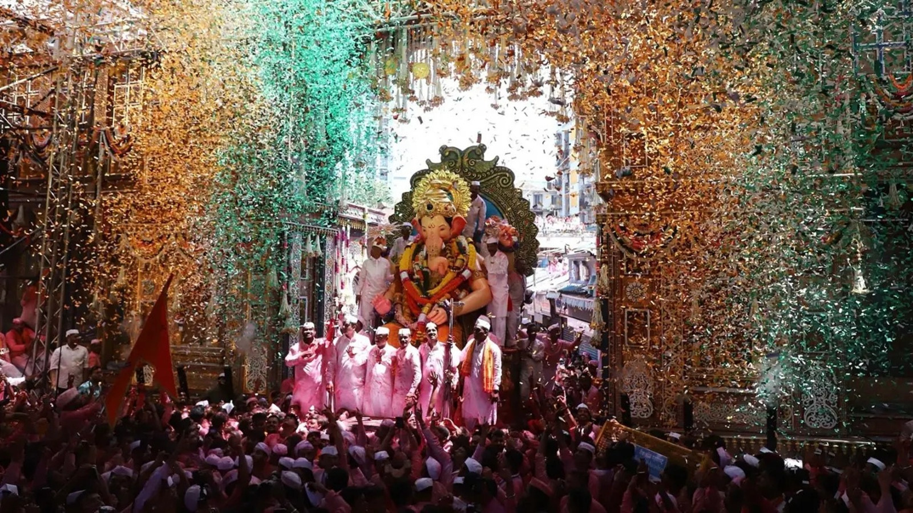
R E D C H A R A J A
GANPATI BAPPA MORYA
Let's welcome Bappa home, together.
15 / 15

